Slide 1



TLIQ
HARDWARES
AtliQ Hardware’s Sales & Finance Analytics
CREATED BY
V.ARUN KUMAR

Slide 2
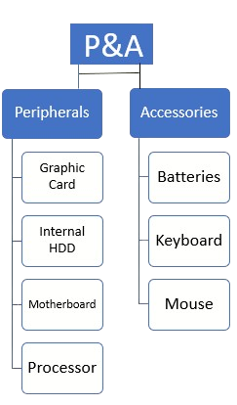
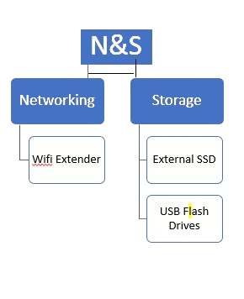
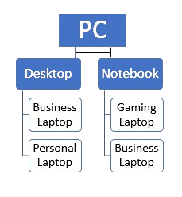
TLIQ
HARDWARES
Company Details
AtliQ Harwares(Imaginary Company) Is a Computer Hardware and Accessories Manufacture
FISCAL YEAR
ATLIQ’S PRODUCTS
FY_2020
SEPTEMBER(2019)-AUGUST(2020)
FY_2021
SEPTEMBER(2020)-AUGUST(2021)
FY_2022
SEPTEMBER(2021)-AUGUST(2022)

Slide 3
TLIQ
HARDWARES
Sales & Finance Analytics
Problem Statement
Project Overview
Key Objectives
AtliQ Hardware aims to gain a deeper understanding of its sales performance and leverage data-driven insights to optimize strategies and improve profitability.
This project focuses on analyzing historical sales data to identify trends, patterns, and areas for improvement.
The analysis will provide a comprehensive understanding of customer behavior, market performance, and product performance.

Slide 4

TLIQ
HARDWARES
Data Exploration and Preparation
1
Data Sources
2
Data Cleaning
The project leverages the fact_sales_monthly dataset and the Target_orders dataset, which provide detailed information about sales transactions, orders, and targets.
The data is cleansed and prepared for analysis by removing leading and trailing spaces, correcting spelling errors, and handling duplicates.
3
Data Transformation
4
Data Exploration
The data is transformed to support various analysis techniques, including calculations of key performance
Descriptive analysis is performed to understand the characteristics of the data, including distributions, outliers, and relationships between variables.

Slide 5
Visualizing Sales Performance Insights
Visualization
Report Link
Insight
Customer Performance
Customer Performance
Identifies top-performing customers and identifies opportunities to improve customer engagement and retention.
Market vs. Target Performance
Market vs Target Performance
Analyzes market trends and identifies areas for improvement in meeting sales targets.
Profit and Loss Statement
P&L Statement by Monthly
Provides a detailed breakdown of revenue, expenses, and profitability across different time periods.
Profit and Loss Statement (Market Wise)
P&L Statement By Market
Examines profitability performance in different markets, highlighting areas for optimization.
Profit and Loss Fiscal Year P&L Statement By FY Provides a detailed breakdown of revenue, expenses, and profitability cross
different Fiscal Years.

Slide 6





Actionable Insights & Recommendations
Sales Optimization
Identify key drivers of sales performance and implement strategies to optimize sales channels, product offerings, and marketing campaigns.
Customer Relationship Management
Develop a targeted approach to customer relationship management, focusing on customer segmentation, engagement, and retention.
Product Strategy
Analyze product performance data to identify areas for improvement, such as product development, pricing, and distribution.
Market Expansion
Explore opportunities for market expansion based on insights into market trends and customer preferences.

Slide 7

TLIQ
HARDWARES

